Slide 1

CMPS 310
Lecture 2
Chapter 1 Part 1:
Introduction
Based on slides prepared by Cyndi Chie, Sarah Frye and Sharon Gray.
Fifth edition updated by Timothy Henry
Copyright © 2018, 2013, 2008 Pearson Education, Inc. All Rights Reserved
Notes:
Socialbot – artificial intelligence program that simulates a human on social media
Going viral – something posted catches attention of people who view/copy/spread
Blog means web log
‹#›

Slide 2
Today
Syllabus
Introduction
The Pace of Change (1.1)
Change and Unexpected Developments (1.2)
Notes:
Some benefits are obvious: Consumers can save time, money, and gasoline while researching products.
Some benefits are less obvious or were not obvious before they appeared: Auction sites give people access to customers they could not have found efficiently before. Lower overhead and ease of comparison shopping have brought down prices of many products. Small businesses and artists can sell directly to buyers, avoiding fees to middlemen and distributors. The Web has enabled a peer-to-peer economy.

Slide 3
SYLLABUS
Notes:
Some benefits are obvious: Consumers can save time, money, and gasoline while researching products.
Some benefits are less obvious or were not obvious before they appeared: Auction sites give people access to customers they could not have found efficiently before. Lower overhead and ease of comparison shopping have brought down prices of many products. Small businesses and artists can sell directly to buyers, avoiding fees to middlemen and distributors. The Web has enabled a peer-to-peer economy.

Slide 4
What We Will Cover
The Pace of Change
Change and Unexpected Developments
Themes of Technology Challenges
Ethics

Slide 5
The Pace of Change
“In a way not seen since Gutenberg’s printing press
that ended the Dark Ages and ignited the Renaissance,
the microchip is an epochal technology with unimaginably far-reaching economic, social, and political consequences.”
̶ Michael Rothschild¹
In his book about the Lewis and Clark expedition, Undaunted Courage, Stephen Ambrose points out that information, people, and goods moved no faster than a horse—and this limitation had not changed in thousands of years

Slide 6

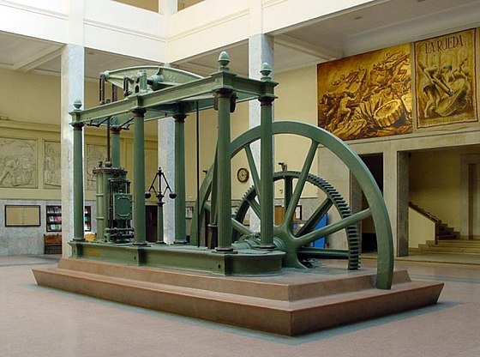
The Pace of Change

Slide 7
The Pace of Change
The industrial revolution occurred roughly between 1760 to 1840
Textiles
Steam Engines
Machine Tools
This led to a transportation revolution where goods could be sent faster and more easily than ever before. But this pales in comparison to the speed of electricity.

Slide 8
The Pace of Change
1940s: First computer was built.
1956: First hard-drive disk weighed a ton and stored five megabytes.
1991: Space shuttle had a one-megahertz computer. Ten years later, some automobiles had 100-megahertz computers. Speeds of several gigahertz are now common.
The iPhone X claims 6 TFLOPS, meaning it’s roughly 37,000 times as fast as the Cray-1, a 70s super computer.

Slide 9
Change and Unexpected Developments
“It is precisely this unique human capacity to transcend
the present, to live one’s life by purposes stretching into
the future – to live not at the mercy of the world, but as a builder and designer of that world – that is the distinction between human and animal behavior, or between the
human being and the machine.”
̶ Betty Friedan³

Slide 10
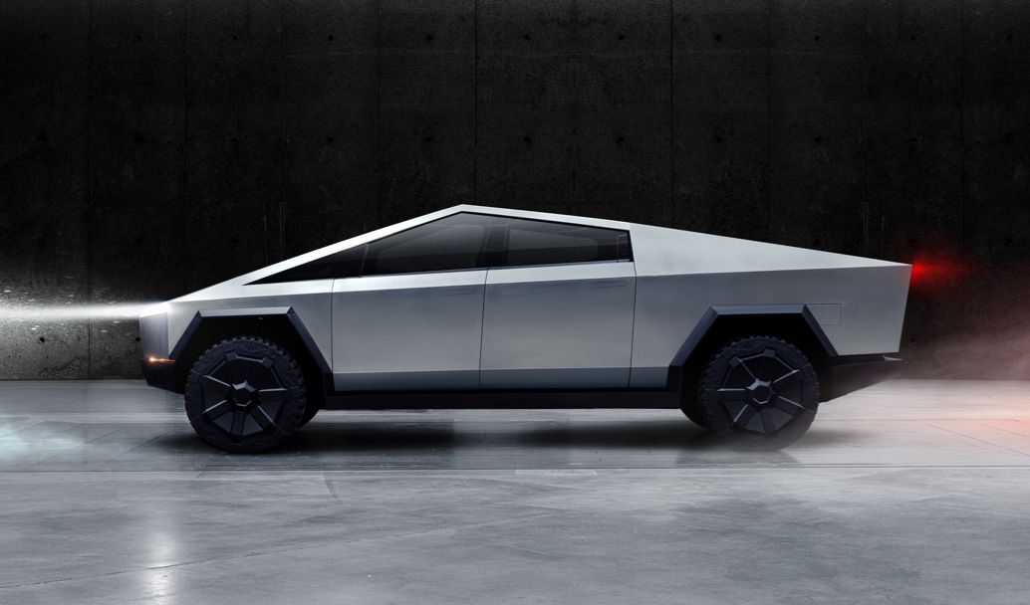
Change and Unexpected Developments

Slide 11
Change and Unexpected Developments
Self driving cars: BENEFITS!
In 2015 it was predicted that there would be millions of self driving cars on the road by 2020, but we now see the reality of it.
How things change if things breakthrough:
automobile mortality rates should go down
more environmentally friendly/energy efficient infrastructure can be developed
commutes become more bearable
less people need to own private automobiles

Slide 12
Change and Unexpected Developments
Self driving cars: Considerations!
Many driving jobs are eliminated. How do we deal with laying off truckers or taxis?
If a person wants to stop to take a picture offroad and there is no available parking for a self driving car, does it prohibit the stop?
Who is at fault in self driving car accidents?
Should passengers be required to have someone who can take over?
If so, would a drunk passenger be at fault if they couldn’t help avoid an automobile accident?

Slide 13
Time to Think
Pick a technology
Name 2 amazing benefits!
Name 2 potential problems?
Notes:
Kills switches could remove content that infringes copyrights. Could also be used to remove content that a company or government deems offensive.
What if malicious hackers found a way to operate the skill switches on our devices?

Slide 14
Homework from 5th Ed
Read Sections 1.1-1.2 (From Today)
Read Section 1.3 (For next time)

